Slide 1
RESPIRATORY EMERGENCIES

Slide 2
CHOKING

Slide 3
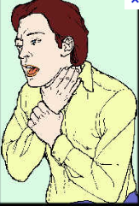

Slide 4
Introduction
This normally occurs when the airway is partially or totally obstructed by a:
Large swallowed object
When something goes down the windpipe rather than the food passage
Muscular spasm

Slide 5
Choking
UNCONSCIOUS
JAW FALLS BACK
AIRWAY OBSTRUCTION
JAW THURST
AIRWAY IS MAINTAINED

Slide 6
Signs and symptoms
Difficulty in breathing, rate and depth increases
Frothing at the mouth
Blueness of lips and finger nails
Confusion
Casualty will be unable to speak
Congestion of the face and neck veins becoming prominent
Possible unconsciousness

Slide 7
Treatment
Remove any debris or false teeth from the casualty’s mouth and encourage the casualty to cough.
Help the casualty to bend over with the head lower than the lungs. Slap the casualty smartly between the shoulder blades with the heel of the hand up to five times: each slap should be hard enough to remove the obstruction by itself.
Check the mouth to see if the obstruction has been dislodged. If it has not, you may be able to remove it by performing abdominal thrust.

Slide 8
Cont’d
a. For the unconscious choking casualty:
Turn the casualty on the back, open the airway and begin artificial ventilation. If this is not successful, roll the casualty on to the side facing you with the chest against your thigh and the head well back and perform up to five back slaps.
Check the mouth to see if the obstruction has been dislodged. If it had, hook it out with your finger. If it has not, turn the casualty on to the back with the head in the open airway position and perform abdominal thrust.

Slide 9
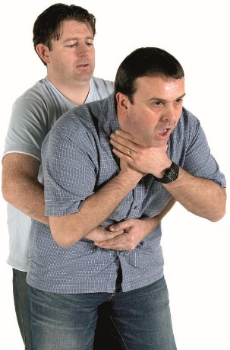
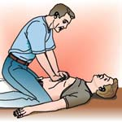
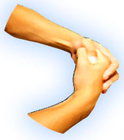
5 Abdominal Thrusts

Slide 10
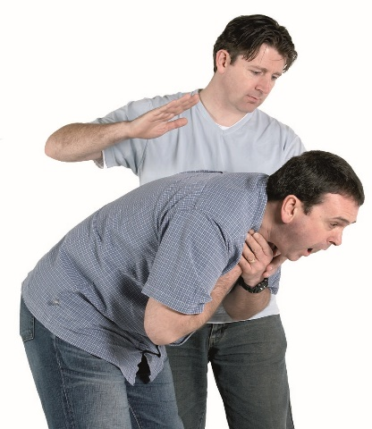
5 Back blows

Slide 11
Cont’d
Check the mouth again to see if the obstruction has been dislodged.
If choking persists, reposition the casualty’s head and attempt artificial ventilation. Then repeat steps 1 to 4 as necessary.
When the obstruction has been removed and the casualty is breathing normally, place in the recovery position and take to hospital.

Slide 12
Cont’d
b. For children:
Big children and small adults are treated in the same way as above.
Small child
Sit in the chair or kneel on one knee and lay the child over your knee, head down.

Slide 13
Cont’d
Support the chest with one hand and slap the child smartly between the shoulder blades up to five times with your other hand.
If this does not dislodge the obstruction, it may be necessary to perform abdominal thrust.
If the child is or become unconscious, place on a firm surface and follow sequence described for unconscious adults.

Slide 14
Cont’d
c. For infants:
Treatment method for infants is the same as for children but much lighter pressure is used and the positions for back slapping and abdominal thrust are different.
Lay the infant’s head downward with the chest and abdomen lying along your forearm and use your arm to support the head and chest. Slap the infant smartly between the shoulders up to five times.
If back slapping does not dislodge the obstruction it may be necessary to perform abdominal thrust.

Slide 15
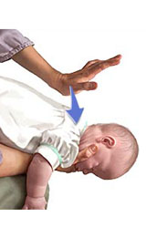
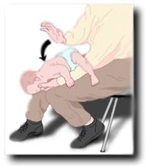

Slide 16
Abdominal thrust for infants
Place the infant on a firm surface with the head in the open airway position.
Place the first two (index and middle) fingers of one hand on the upper abdomen, between the navel and the breastbone and press with a quick forward and downward movement.
Repeat up to five times as necessary; each thrust must be hard enough to dislodge the obstruction.

Slide 17
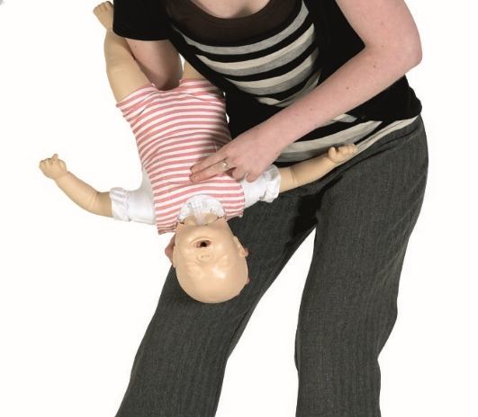
5 Chest Thrusts

Slide 18
Cont’d
Check the mouth again. If the obstruction is visible but not coughed out, hook it out with your fingers.
If choking is not relieved, repeat back slaps (up to five times) and abdominal thrust (up to five times). If casualty becomes unconscious, treat as described earlier.
The casualty may begin breathing again at any stage. When this happens, advise the casualty to sit quietly and give sips of water as necessary.

Slide 19
Precautions
Use extreme caution when removing an obstruction from the mouth of an infant.
Only put your finger in the mouth, if you can see the obstruction and there is no danger of pushing the obstruction further down the throat.

Slide 20



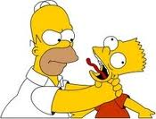
The Do and Don’ts for First Aid Treatment
DIAGNOSIS
CHOKING ASK! Are you choking? If the victim able to talk, groan, wheeze or cough, he is partially choked. | Slap the victim back’s hard. Using your fingers to force out the item out of the victim’s mouth. | Remain calm and encourage the victim to keep coughing to try and clear the blockage. Stand slightly behind the person to one side. Support their chest with one hand. Lean the person forward so that the object blocking the airway will come out of their mouth, rather than going further down. Give at least 5 sharp blows between the person’s shoulder blades with the heel on your hand. Stop after each blows to check if the blockage has cleared. If not, give up to five abdominal thrusts.

Slide 21
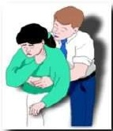
The Do and Don’ts for First Aid Treatment
DIAGNOSIS
CHOKING Complete blockage If the victim unable to make any sound at all. | Using your fingers to force out the item out of the victim’s mouth. | Steps in Abdominal thrusts Stand behind the person who is choking. Place your arms around the waist and bend them well forward. Clench your fist and place it right and place it right above the person’s navel (belly button) Place your other hand on top, thrust both hands backwards into their stomach with a hard, upward movement. Do it five times (1 cycle), stop each cycle to check if the blockage has been cleared. Alert! Do not thrusts on pregnant and on a very large sized adult.

Slide 22
DROWNING

Slide 23
Introduction
Drowning causes asphyxia by water entering the lungs or by causing the throat to go into spasms so constricting the air passage (known as dry drowning).
What happens in drowning?
Drowning is a major source of accidental death and can be a result of cold, fatigue, injury, disorientation, intoxication etc. or the victim’s own limited swimming ability.
The drowning victim struggles to inhale air as long as possible but eventually he goes beneath the water where he must exhale air and inhale water.

Slide 24
Effect of drowning
Airway obstruction
Asphyxia
Congestion of lungs
Injuries to head and neck
Internal injuries (broken bones, soft tissue injuries, internal bleeding)
Hypothermia

Slide 25
Signs and symptoms
General symptoms and signs of asphyxia.
Froth around the casualty’s lips, mouth and nostrils.

Slide 26
Treatment
1. Reaching the victim:
Pull the patient from the water using rope, branch, fishing pole, stick, towel, shirt. Lie down flat on your stomach and extend your hand or leg.
Throw him an object that will float with line i.e. tyre, foam cushions, logs, boards, plastic toys.
Use boat and life jacket, if available.
Tow the victim to the shore.
Do Not: Swim to the patient.

Slide 27
Cont’d
2. Stabilization of the victim in the water:
Keeping the victim’s head and body aligned, place one of your hands in the middle of his/her back. Your arm directly over the victim’s head.
Place your other hand under the victim’s upper arm, near the shoulder.
Slowly and carefully, rotate the victim over in the water by lifting the shoulder up and rotating it over.
Support the victim in neutral position in water, start mouth-to-mouth ventilation.

Slide 28
Cont’d
3. Resuscitation:
Quickly remove any obstructions such as sea-weed, mud from nose and mouth, start artificial ventilation immediately. It is possible to begin ventilation even in water.
If within your depth, use one arm to support the casualty’s body and use the other hand to support the head and seal the nose while you perform mouth-to-mouth ventilation.

Slide 29
Cont’d
If in deeper water, give the occasional breath of air while towing the casualty ashore.
Turn the victim face down with head to one side and arms stretched beyond his head.
Use postural drainage to clear water aspiration.
Child:
Child and infant can be held upside down for a short period. Raise the middle part of the body with your hand round the belly. This will cause water to drain out of lungs.

Slide 30
Cont’d
Adult:
Raise the middle part of the body as in children. Press the chest and coastal margin to press the lungs and to remove water from the lungs.
Check breathing and heart beat and continue resuscitation, if necessary.
As soon as breathing begins, keep casualty in recovery position.
Remove wet clothing. Keep the body warm, cover with blankets. Give hot drinks, coffee and tea.
Do not allow him to sit up.
Shift casualty to hospital in recovery position.

Slide 31
Things to remember..
The chance for survival in warm water is much less than in cold water. The colder the water, the better the chance for survival.
In fresh water drowning, water passes trough the lungs into the circulation and may cause dilution of blood. This interferes with oxygen exchange.
In salt water drowning, salt from the aspirated water causes the loss of large amounts of fluid from the circulation into the lungs. This causes water accumulation in the lungs and death.

Slide 32
STATUS ASTHMATICUS

Slide 33
Introduction
This is a serious condition of the lung in which muscles in the air passage go into spasm.
The airway becomes constricted making breathing particularly breathing out very difficult.
These attacks can be triggered off by allergy, infection, anxiety or tension.

Slide 34
Signs and symptoms
Shortness of breath
Difficulty in breathing especially breathing out
Blueness and congestion of face
Anxiety
Difficulty in speaking

Slide 35
Treatment
Reassure and calm the patient.
Make him sit up in bed or chair and allow him to lean forward with a few pillows or table on which to rest his head.
Ensure a good supply of fresh air.
If the casualty has medication, allow him to take it because it may give relief.
Shift the casualty to hospital.

Slide 36
ASPHYXIA

Slide 37
Introduction
Asphyxia is a condition in which the lung do not get sufficient supply of air for breathing. If this continues for some minutes, breathing and heart action stop and death occurs.
Causes
Conditions affecting air passage e.g. obstruction, compression etc.
Injury to the lungs
Injury to the chest wall

Slide 38
Cont’d
Conditions affecting the respiratory mechanism
Conditions affecting the brain or nerves which control respiration e.g. electrical injury, poisoning, barbiturate use.
Conditions affecting the amount of oxygen in the blood.
Conditions preventing the use of oxygen in the body e.g. carbon monoxide poisoning, cyanide poisoning.

Slide 39
Signs and symptoms
Difficulty in breathing
Veins of the neck become swollen
Noisy breathing
Face, lips, nails, fingers and toes turn blue (cyanosis)
Tachycardia
Unconsciousness
Froth may appear at mouth and nostrils
Fits may occur
Breathing may stop

Slide 40
Treatment
Remove the cause of asphyxia and open the airway
If the casualty is not breathing, begin artificial ventilation or mouth-to-mouth respiration immediately
When breathing and pulse return, place the casualty in recovery position
Check breathing rate, pulse and level of consciousness at ten minute interval
Send casualty to hospital

Slide 41
STRANGULATION, THROTTLING, HANGING

Slide 42
Introduction
In strangulation, throttling and hanging neck is pressed from outside so that airway is closed and blocks the flow of air into the lungs.
Strangulation
It involves cutting off the air supply by a tight constriction around the neck.
Throttling
It involves cutting off the air supply to the neck by intentional squeezing of a person’s throat as in an assault.
Hanging
It involves suspension of the body by the neck.

Slide 43
Signs and symptoms
Symptoms and signs of asphyxia
Congestion of face and neck with prominent veins
Marks of constriction may be visible around neck
Body may still be suspended

Slide 44
Treatment
Remove the constriction from around the neck immediately, supporting the weight of the body if it is hanging. Always cut below the knot.
Place in recovery position if casualty is unconscious but breathing normally.
If breathing is difficult, start CPR.
Shift the casualty to hospital.

Slide 45
SMOKE INHALATION

Slide 46
Introduction
A fire uses up oxygen in the atmosphere so the oxygen level in a burning room is low and asphyxia may result.
Smoke may irritate the throat which can go into spasm and close the airway.
Plastic coverings and foam padding of modern buildings give off toxic fumes during burning which can be fatal.

Slide 47
Signs and symptoms
Symptoms and signs of asphyxia
Burns over the body
Symptoms and signs of shock due to burns

Slide 48
Treatment
Remove the casualty from fire and smoke to safety.
Extinguish any clothing that is on fire.
Put wet cloth over the mouth and nose (self) as well as the casualty.
If the casualty is unconscious but breathing normally, then place him in recovery position.
If breathing is difficult or has stopped. Begin artificial ventilation immediately.
Treat any burns and scalds.
Shift casualty to hospital.

Slide 49
SUFFOCATION

Slide 50
Introduction
This occurs when:
Air is prevented from reaching the air passages by an external obstruction such as plastic bag, soft pillow or fall of mud
A person is kept in a confined space then all the available oxygen is used up

Slide 51
Signs and symptoms
Symptoms and signs of asphyxia
Air tight seal over the mouth and nose
Presence of stale air in confined space

Slide 52
Treatment
Immediately remove any obstruction or remove the casualty to fresh air
If the casualty is conscious and breathing normally, reassure and observe
If he is unconscious but breathing normally place in the recovery position
If breathing is difficult or stopped, begin artificial ventilation immediately
Shift the casualty to hospital immediately

Slide 53
SUFFOCATION BY POISONOUS GASES

Slide 54
CARBON MONOXIDE POISONING
Carbon monoxide gas is dangerous because it replaces the oxygen already present in the blood.
It is more readily absorbed by the blood than oxygen and a casualty may require prolonged artificial ventilation to clear completely.
This gas is lighter than air.

Slide 55
Sources of carbon monoxide gas
Car exhaust fumes
Partially burnt fuels
Household coal gas
Coal mines
Charcoal stores combustion

Slide 56
Signs and symptoms
Symptoms and signs of asphyxia
Headache
Color may be normal but will deepen to cherry pink as the level of carbon monoxide in the blood rises.
Confusion
Difficulty in breathing
Unconsciousness may develop

Slide 57
Treatment
Cut off the source of gas.
Open the door and windows of the room and ensure fresh air.
Before entering the enclosed space, take two or three deep breaths and hold your breath as long as you can.
Crawl along the floor (as the gas is lighter than air).
Remove the casualty as quickly as possible for fresh air.
If breathing is difficult or stopped, start artificial respiration.
Shift the casualty to the hospital immediately.

Slide 58
CARBON DIOXIDE AND OTHER GASES
Sources:
Coal mines
Deep unused wells
Sewerages
Butane and propane are used at home and in industry for heating, lighting or refrigerating and can leak from faulty connections.
Signs and symptoms:
Same as in carbon monoxide poisoning.

Slide 59
Treatment
Observe all the precautions mentioned in carbon monoxide poisoning management.
Enter in the room or mine in upright position (as the gas is heavier than air and collects near the floor.
Remove the casualty to fresh air.
Use gas mask to protect yourself if available.
If there is difficulty in breathing or it has stopped, then give artificial ventilation. Shift the casualty to hospital immediately.

Slide 60


